Slide 1

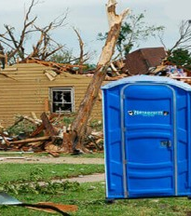
Disaster Sanitation
DEEP Survival Basics Workshop
March 21, 2026

Slide 2
Background
Recent disasters in the United States, Japan and New Zealand have damaged parts of water and wastewater systems, leaving people without access to clean water and flushable toilets for long periods.
This has exposed the need for earthquake prone cities to improve post-disaster sanitation management plans and educate communities on how best to manage human waste.
The need is even greater for those of us living in the Cascadia region. The Cascadia Subduction Zone earthquake will create a regional disaster unlike anything the modern U.S. and Canada have ever experienced. It will take considerable time for outside assistance to arrive.
Assumptions
These recommendations are only for the first 2-4 weeks following a major earthquake. They are based on the following assumptions:
- Sewage collection and treatment systems will be partially or fully out of service for many months following a large earthquake.
- Methods for handling sanitation must be simple and cheap. They must effectively protect public health by limiting exposure to human waste.
- No single sanitation method is right for every situation – there must be several options to handle a variety of situations.
- Portable toilets work well during smaller events, but the number required for this scenario is far greater than what will be available. Additionally, they require frequent cleaning and emptying, which would be very challenging.
- Within 30 days of the initial disaster, local governments should be able to provide further messaging and instructions regarding human waste.

Slide 3
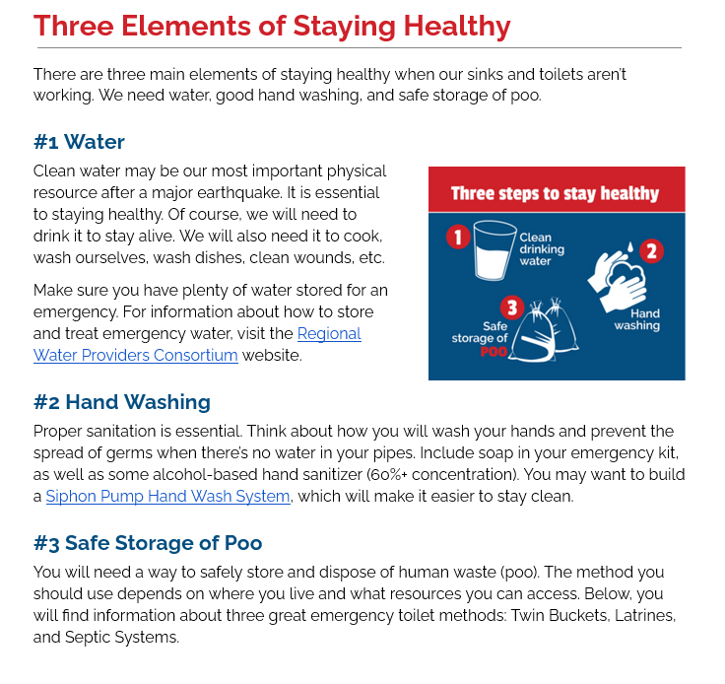
After a major earthquake, we may need to live without running water and working toilets for days, weeks, or possibly months.
To stay healthy, we will need water and good sanitation practices. Deadly diseases can spread when human waste is not handled and sequestered safely.

Slide 4
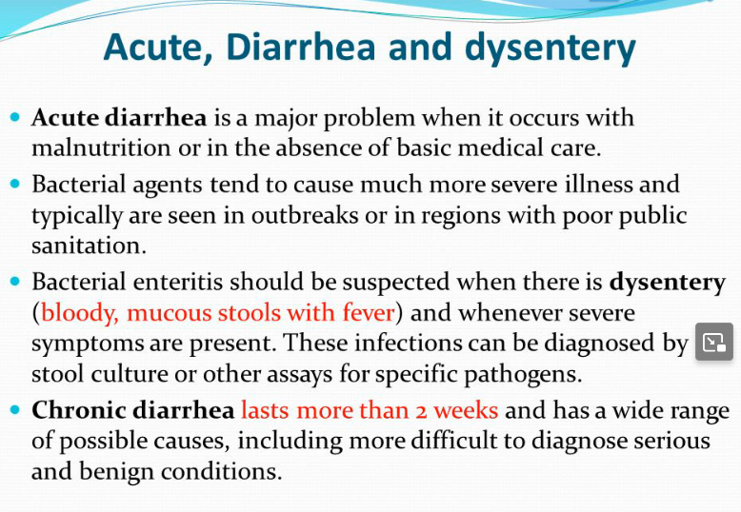

The Most Likely Problems to Emerge

Slide 5


Other Gastrointestinal Threats

Slide 6

What is Dysentery?
A broad and somewhat archaic term, ‘dysentery’ is any severe diarrhea and/ or vomiting caused by pathogens in the digestive system
Major cause of death in disasters. Especially, but not exclusively, for children, the immuno-compromised, the dehydrated, and the elderly

Slide 7

Your digestive system triggers diarrhea and vomiting, attempting to rid the body of the pathogen.
Usually, it works.
A few days of misery, and then you may start to feel better…..
In a disaster situation, medications to help speed the recovery process may not be available.
People may be less able to resist infection due to stress, lack of sleep, malnutrition and/ or injury.
The most important intervention – imbibing more water – may be severely constrained by a general lack of potable water. An unpleasant event can become life threatening.

Slide 8
What are the causes of dysentery?
The parasitic and bacterial infections that cause dysentery are very contagious. People usually transfer the parasite or bacteria to each other when poop (fecal matter) from an infected person gets into another person’s mouth. This is known as the Fecal-Oral Route. Transmission can occur during:
Food preparation by someone who doesn’t wash their hands or has poor hygiene.
Drinking contaminated water.
Contamination of food and other commonly touched surfaces by flies, rats, and other vectors

Slide 9



Q: Why Worry About Dysentery?
A: Because Dysentery makes life Miserable, is contagious, and can be fatal in the crude conditions likely to exist post quake.
Risk to the Community
- this is a very common problem in disasters, refugee camps, among the homeless
- it can be a major cause of death in these settings, often surpassing the inciting disaster
- on a larger scale, it chips away at resilience and impedes the recovery process

Slide 10
What Can We Do?
Stop the Five Ways germs get from one person’s rear end to another’s mouth:
- Fingers – hand washing
- Food – handwashing, dish washing, keeping flies and other critters away from food
- Flies – treat waste, cover bucket toilets, sequester feces in bags
- Fields – if ground is the only options, bury it well and as far away as possible
- Fluids – keep waste as far away from clean drinking water sources as possible
The infrastructure system around us does all of this for us now. After a disaster, we need to do this for ourselves.

Slide 11

1) Fingers & 2) Food
Make hand washing or Sanitizing Easily Available Where Needed
- Near Toilets, and Near Food Prep Areas
- Food prep area must have Soap & running water
- Toilets must have soap and water where fecal matter is an issue
Hand sanitizer – while useful to have around for preventing upper respiratory infection – is not adequate for interrupting fecal-oral transmission.
Handwashing stations need to be Pre-Assembled or Purchased before a disaster
Pre-stored water will be needed, and replenishment will be an ongoing need

Slide 12
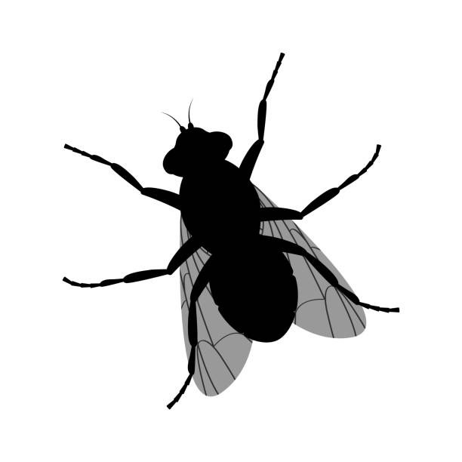
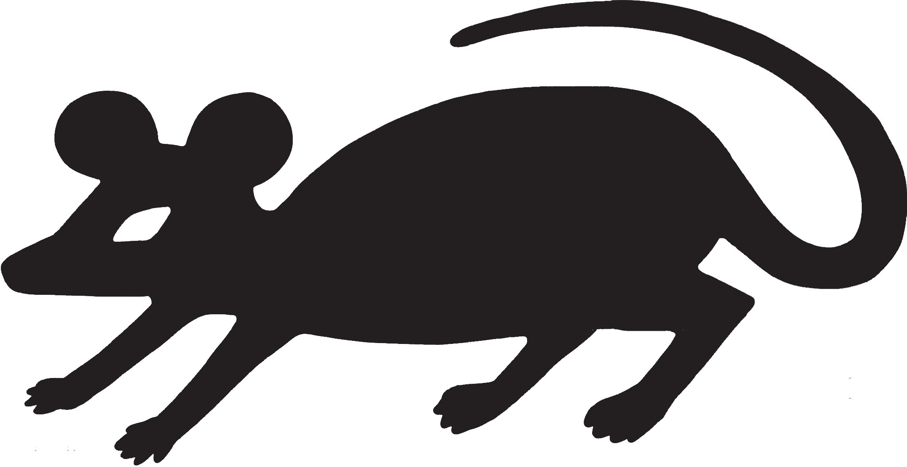
3) Flies
Flies, and to a lesser extent mice, rats and other pests are now a real and serious enemy in a disaster situation.
They eat shit, then walk all over your food, looking for more to eat. They are relentless, and implacable.
To discourage flies, all fecal matter needs to be covered with seat covers, and a drying material needs to be applied.
Food must be covered and secured.
However, DON’T cover feces buckets airtight (can foster growth of anaerobic bacteria such as botulism, which is incredibly dangerous)

Slide 13
Fields and Fluids
Simple – set the site of your toileting stations well away from where you will be eating, working and sheltering
- keep the station close enough to be functionally useful
- have it sheltered from the elements
- allow for privacy
- maintain the stock of toilet paper, desiccating material, and water and soap for the handwashing station

Slide 14
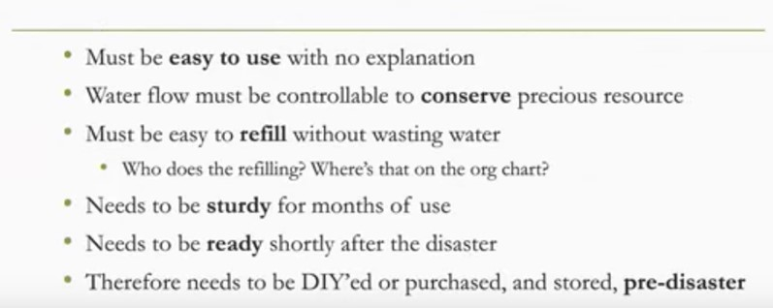
Handwashing Hardware

Slide 15
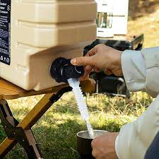
Handwashing Station Types
Spigot on Container
Commonly available, easy to use
However, if hand operated, the handle will get contaminated and act as a major source of infection
Better: if the spigot can be rigged to be foot operated, this avoids this problem.

Slide 16
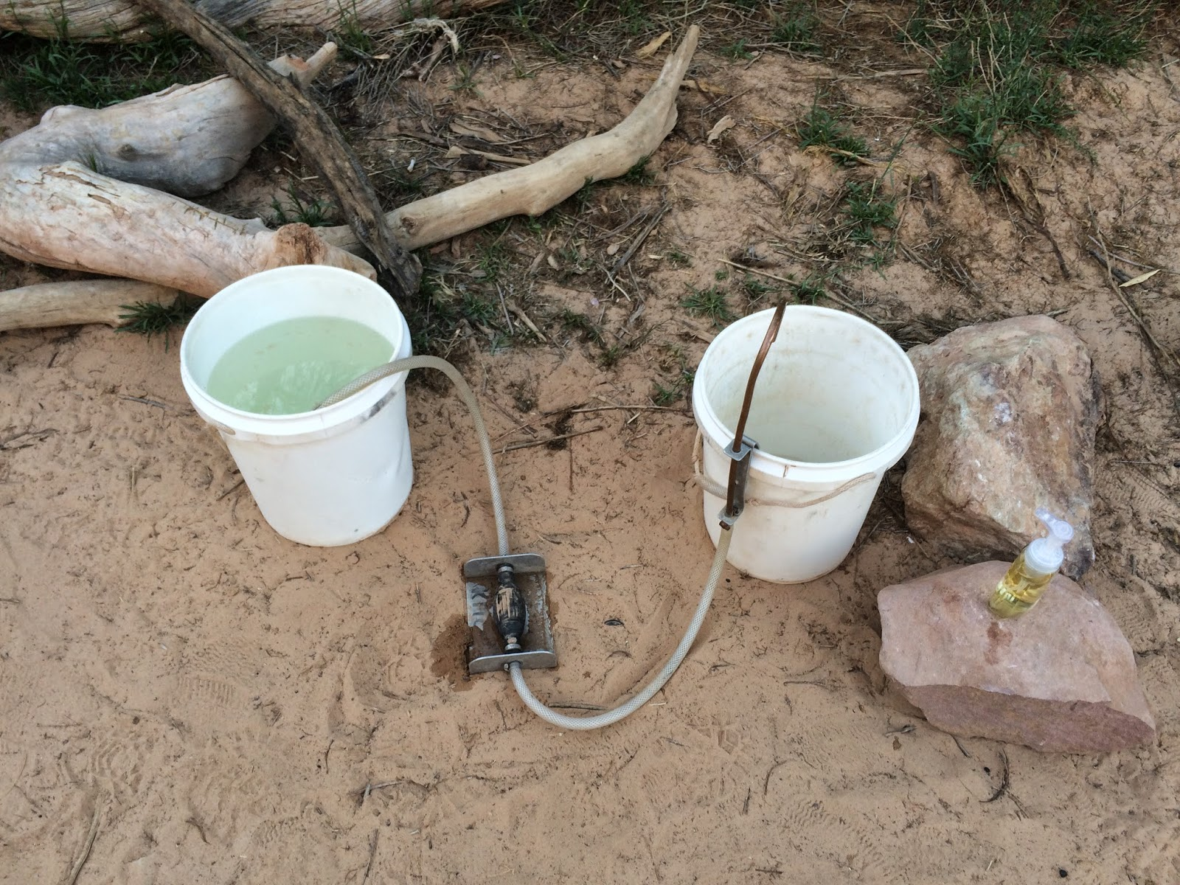
Foot Operated Pump
Sanitary & Water Efficient
Takes moderate skill to make at home
Can be constructed for +/- $40.00
https://www.oars.com/blog/how-to-make-an-easy-and-affordable-hand-washing-station/

Slide 17
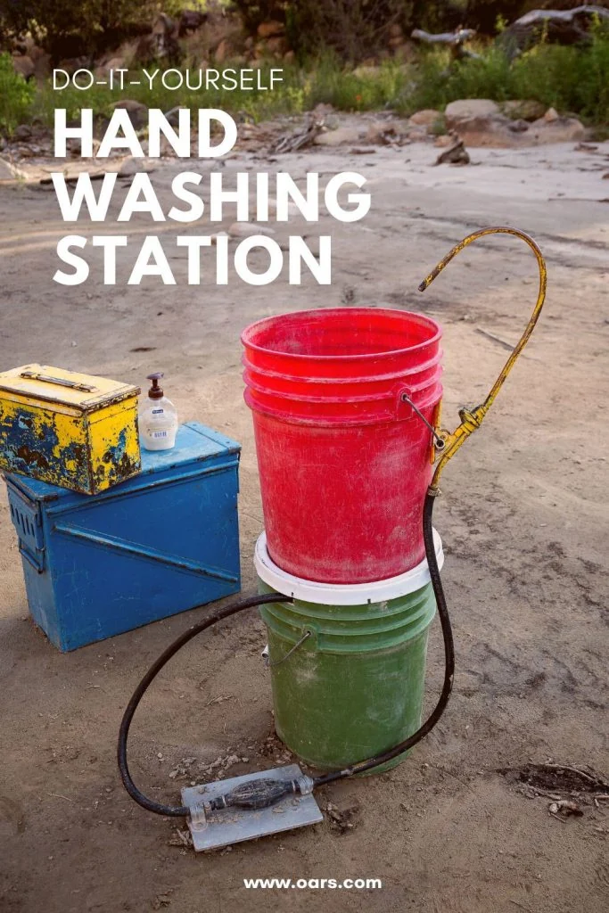
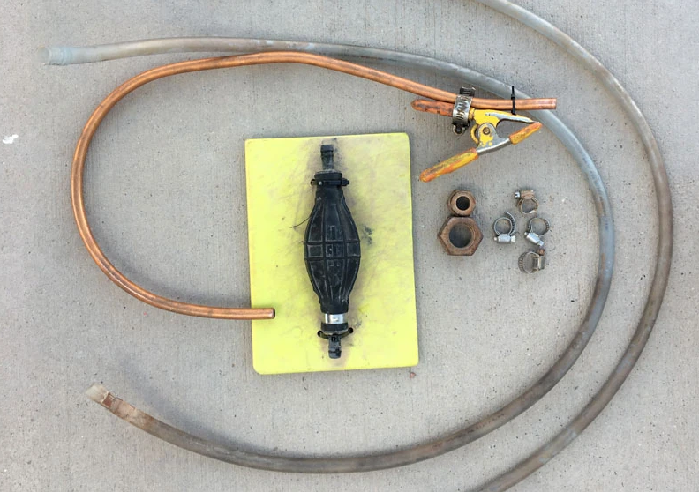
Foot Operated Water Pump
What You’ll Need
2 – 5-gallon buckets
1 – lid for bucket
~80″ 3/8″ interior diameter vinyl tubing
~30″ 3/8″ exterior diameter copper tubing
5 – hose clamps
1 – spring clamp
1 – primer bulb (with 3/8″ barb ends)
~ 6″ x 8″ piece of old cutting board, wood, etc.
5-8 – long heavy duty zip ties
Copper or steel tape, ¾ wood screws
4-6’ garden stake

Slide 18
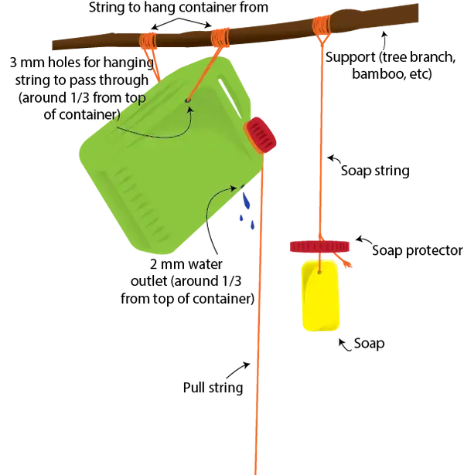
Tippy Tap
Easy to make, hard to aim and thus wasteful of water
Best used outdoors

Slide 19
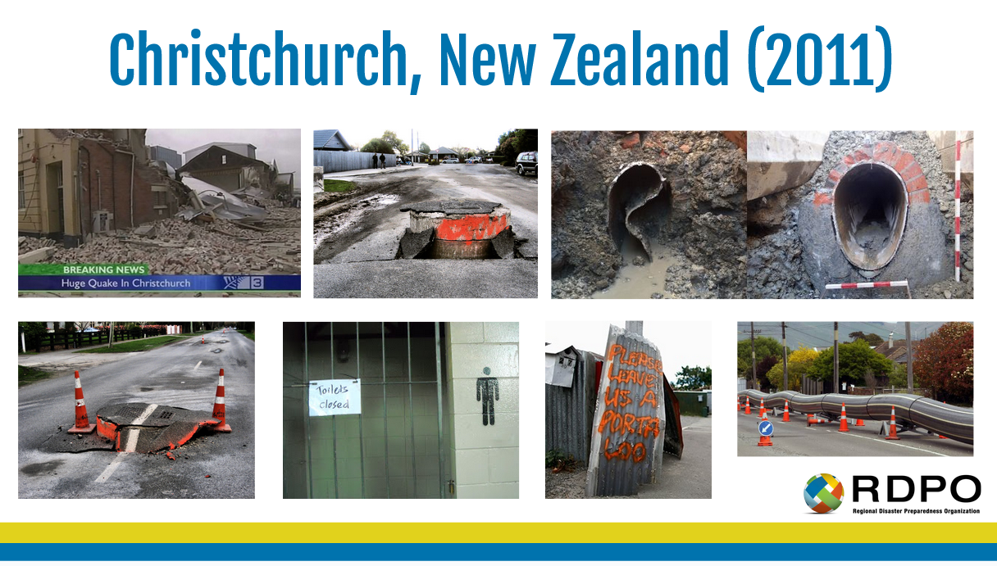
Urine & Feces Agenda
Remember the ‘Golden’ Ratio: One Toilet per 20 People in a Post Disaster Situation!

Slide 20
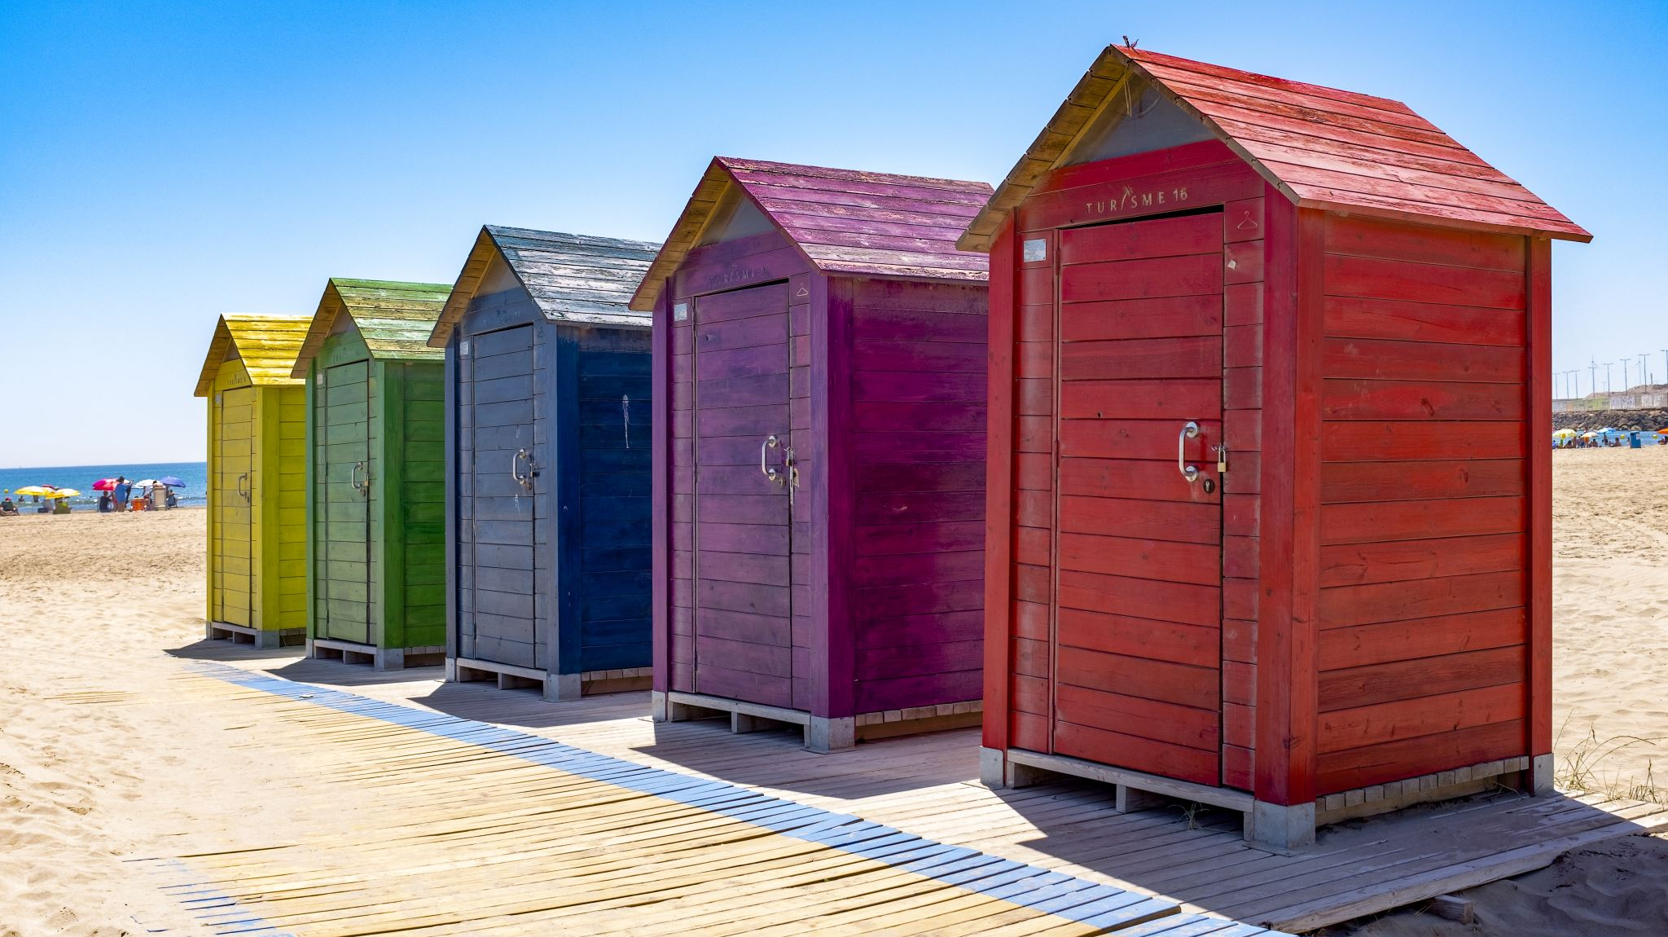
Portable Toilets

Slide 21
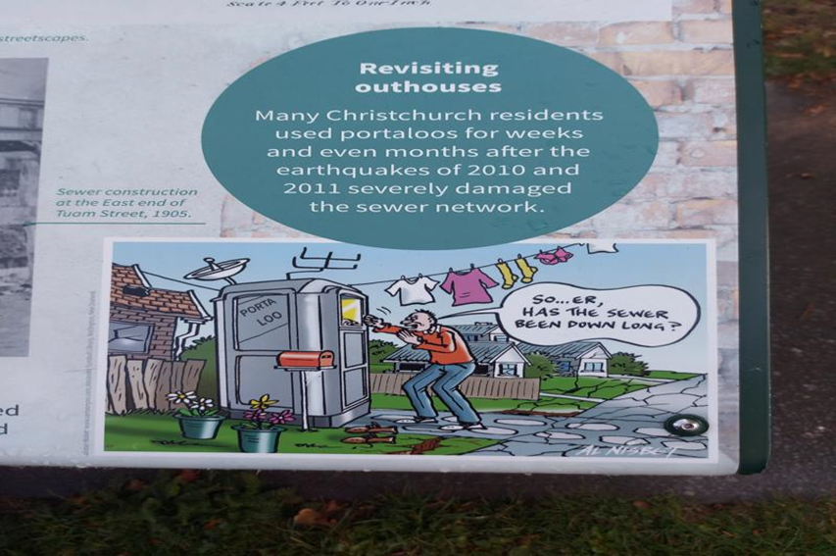
Portable Toilets – Not a Viable Solution
Unit is outside of house (poor safety). Multiple houses would use one unit, which often leads to units being poorly maintained. There is potential for vandalism.
Estimated +/- 200,000 in all of Canada; 20,000 portable toilets in B.C. would only be adequate for 400,000 people (not enough for Vancouver by itself).
Challenges of road access for emptying. Fleet of trucks required.
Concentrated effluent would have to be stored for drip-feeding into treatment plant.

Slide 22
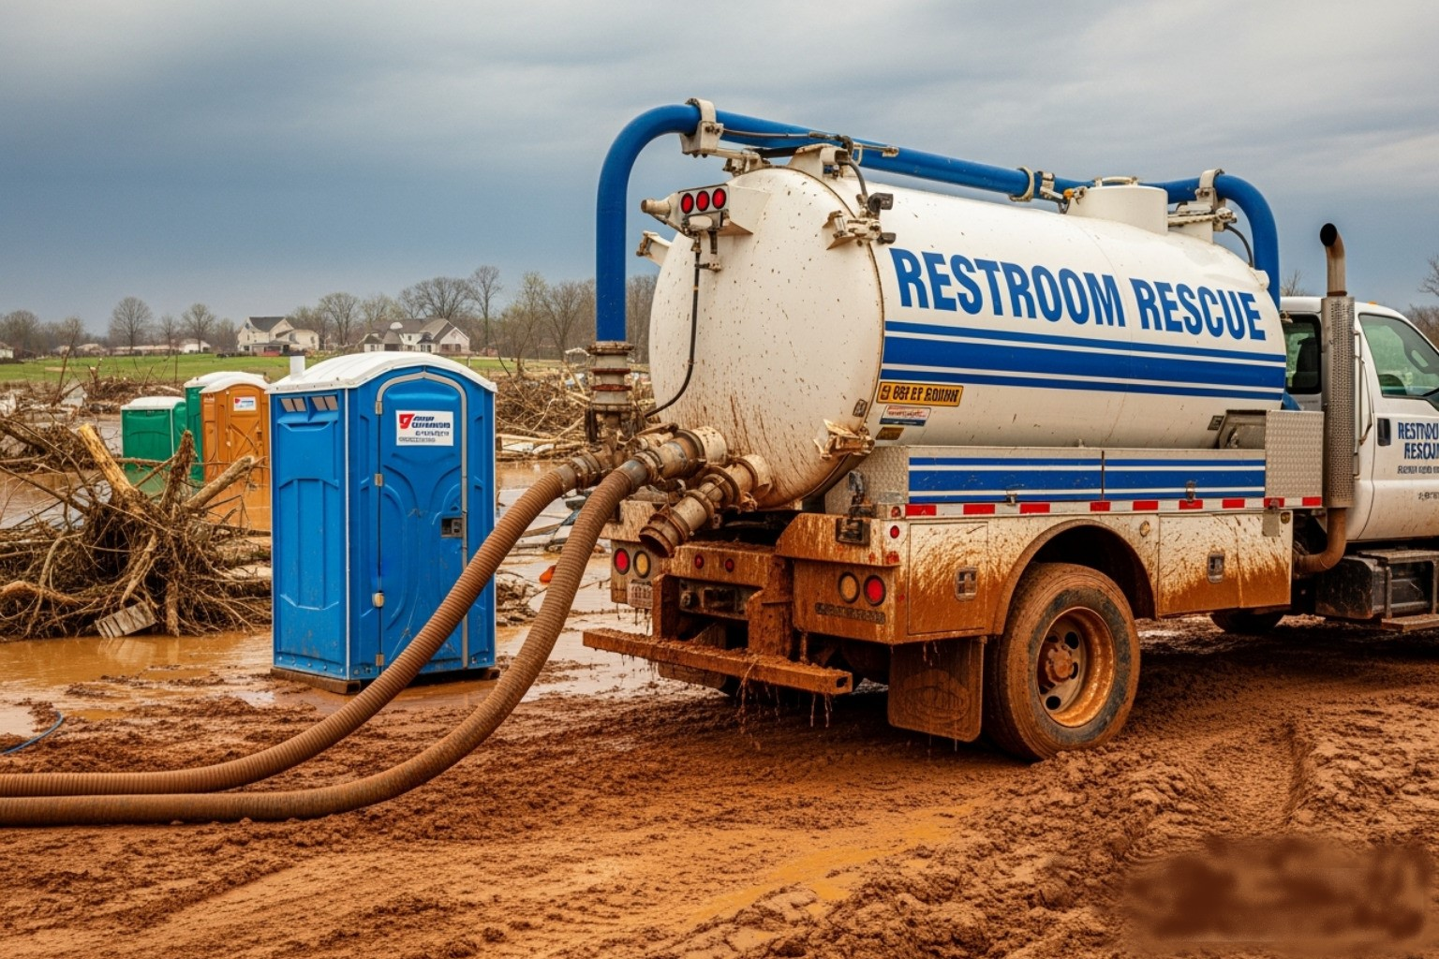
Post Disaster
Deluxe
Sanitation

Slide 23
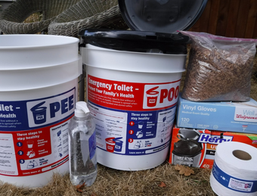
Two or Twin Bucket
Method 1 - Twin Buckets
The Twin Bucket method separates pee and poo into two buckets. This lessens volume and odor, making bucket contents safer and easier to store and dispose of. This method is ideal for dense urban areas with limited open space and a high water table, which is common in the Portland Metro Region.
The Twin Bucket system was developed in Christchurch, New Zealand after earthquakes in February 2011. The system is simple, effective, and inexpensive.
Materials:
Two sturdy plastic buckets. Five or six gallon buckets work best. Label one PEE or #1 and the other POO or #2. You can print bucket labels and use packing tape to secure them to your buckets.
A toilet seat. You can adapt a regular toilet seat or buy a seat that is designed for use with buckets (available online and at most camping or emergency supply stores). If you can, purchase two seats - many people prefer to sit when going pee. Do not use a pool noodle. If they develop any cracks or start to break down, they become impossible to fully clean, which increases the risk of spreading disease.
Toilet paper
Layering material. You will use this to create layers each time you use your poo bucket. A carbon-based material works best. It should be lightweight, dry, and organic. The goal is to absorb moisture, reduce odor, and deter flies. You’ll need about a handful to cover each poo. Examples: sawdust, shredded paper, bark chips (avoid cedar), dry leaves, dry grass clippings, peat moss, toilet paper, hamster bedding, etc.
Heavy-duty plastic garbage bags. 13-gallon size, 0.9 mil or thicker.
Privacy Shelter

Slide 24

The Urine Bucket
Using the ‘Pee’ Bucket:
Pee in the pee bucket, but put your toilet paper in the poo bucket.
Dilute the pee with water (if possible). Remove bucket by hand after every use to dump out. Spread it on a permeable surface, such as a lawn. Local governments may develop alternative urine collection sites in order to avoid water table contamination.
Urine is not dangerous to people on its own; very few germs
A person produces about 2 litres per day; a bucket will fill up fast, so dump out every time

Slide 25
The Feces Bucket
Using the ‘Poo’ Bucket:
Line your poo bucket with a heavy-duty trash bag.
Poo in the poo bucket, and add your toilet paper.
After each use, cover the surface of the poo with a layering material (pelletized garden lime is best for this). This will help reduce odors and deter flies.
  Do not put an airtight lid on the bucket. Allowing some air flow will help the poo dry out and reduce in volume and weight.
  Do not fill the bucket more than halfway full. You don’t want the bag to become too heavy or difficult to close.
When the bag is half full (or less), tie the top of the bag.
Store your poo bags safely away from food and water, kids, pets, flies, rats, etc. Consider talking with neighbors to create shared collection sites.
Be careful when using the poo bucket, bagging the contents, and storing the bags. Afterwards, always wash your hands with soap and water or hand sanitizer.
Look for instructions from public agencies on how to safely dispose of poo bags.
  Utilizing one neighbourhood organics container (i.e. a green bin) per street or half block at a time in the absence of alternatives
  Never dig a hole and bury your poo bags.
FECES is dangerous to human health in any amount
A person produces about 6 ozs per day
If urine mixes with feces, it becomes a dangerously infectious (and smelly) combination

Slide 26
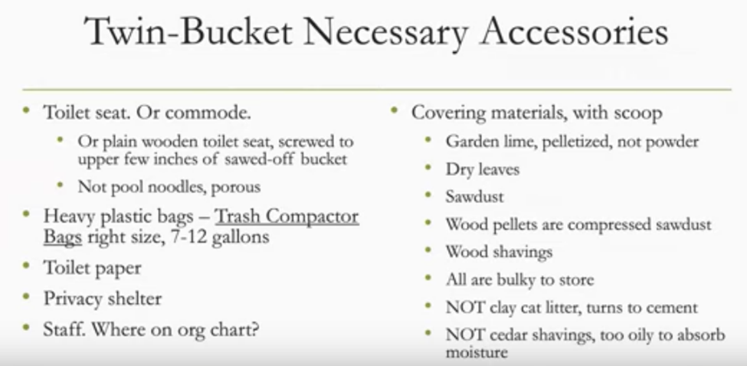
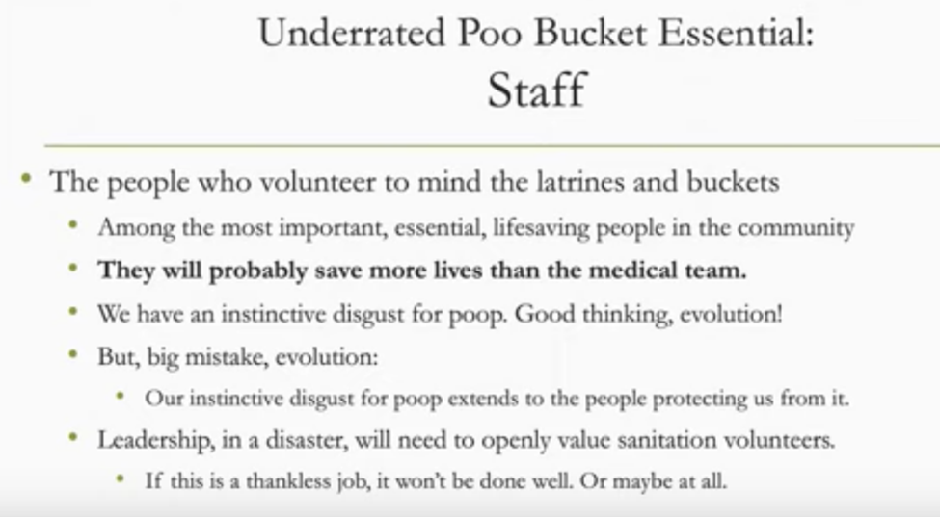
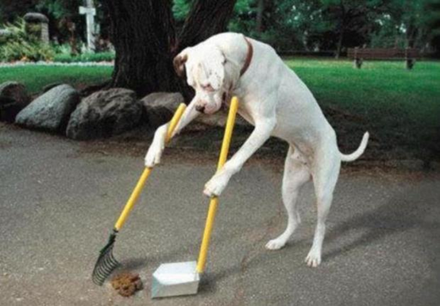
Twin Bucket System Final Thoughts

Slide 27
Method 2 - Latrines
A latrine (or a pit toilet) is a hole in the ground that collects human waste (poo and pee) in an emergency. This method is also simple, cheap and effective. It’s ideal for more rural areas with wide open spaces. It can still be used in urban areas, as long as location guidelines (see below) are followed.
Before a Disaster:
Learn where your underground utilities are located. You may not be able to contact your utility company after a major earthquake.
Strata councils, property managers, and multi-family dwellings should pre-identify locations for latrines.

Slide 28
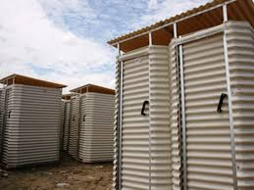
Latrine Design
Instructions:
To minimize the number of holes you need to dig, talk with your neighbors about using shared pits. Make sure everyone agrees about the location of pits.
Dig a hole, and save the soil that you removed.
Location: It should be at least 10 feet from your residence, 10 feet from your property line, and 100 feet from creeks and wells.
Depth: Dig down at least two feet. Four feet is optimal, but many areas have a high water table. If you see water, stop and find another location or use the Twin Bucket Method.
Width: The hole should be about two feet wide.
After each use, cover your poo and pee with dirt.
When filled to the one-foot level, consider the latrine full. Allow space to cover it with at least an additional foot of dirt.
Mark the location of each latrine so they can be treated during disaster recovery.
Dig a new hole as needed.
Used toilet paper goes into the latrine, but nothing else. Do not bury plastic bags, diapers, feminine hygiene products, or anything else.

Slide 29
Final Thoughts
Do I need a toilet seat?
No, but you’ll be much more comfortable if you have one. You could get creative with ways to make the top of a bucket more comfortable to sit on using everyday objects, but be mindful of the material. It should be smooth and easy to clean - not be absorbent.
If I pour pee in my garden, will it kill my plants?
Urine (pee) is relatively harmless unless you have kidney disease or another illness that causes your body to expel toxins in large quantities. Urine is mostly made up of water and nitrogen, which is a key component of fertilizer. If you dilute urine with water and pour it in a different place each time, your plants should be fine.
Where should I put used feminine hygiene products and diapers?
Put feminine hygiene products in the poo bucket if you are using the Twin Bucket system. Otherwise, dispose of feminine products in your regular garbage bin. Diapers should always go in regular garbage.
Why not compost poo?
Fecal matter can be composted, but it takes special knowledge, materials, and lots of time (1-2 years) to do it safely. It’s not like composting kitchen scraps. If done incorrectly, it could create a major public health issue. Most people don’t know how to safely compost poo, and after a major earthquake, most people won’t have access to the internet to learn. Our recommendation is to contain poo in bags (or dig a latrine, when appropriate).
Why put poo in bags? Why not just store it in lidded buckets?
After a major earthquake, we could be without running water and flushing toilets for weeks - maybe even months. If you can’t flush, it is better to contain poo elsewhere and keep your bathroom area clean.
If you poo directly into an unlined bucket, you will need to dispose of the poo once it fills so that you can keep using the bucket. If you pour the contents into another container, it will splash and create an unsafe mess. Even if you have multiple buckets, you will eventually need to pour that poo into another container. It’s just not safe. Bagging poo allows you to store it when it gets full and keep using the bucket. It keeps the poo in one place - no transferring, no splashing.

Slide 30
References
Emergency Toilet Guidebook
Created by the Regional Disaster Preparedness Organization of the Portland Metropolitan Region with funding from the U.S. Department of Homeland Security/Urban Areas Security Initiative (UASI) grant program.

