Slide 1
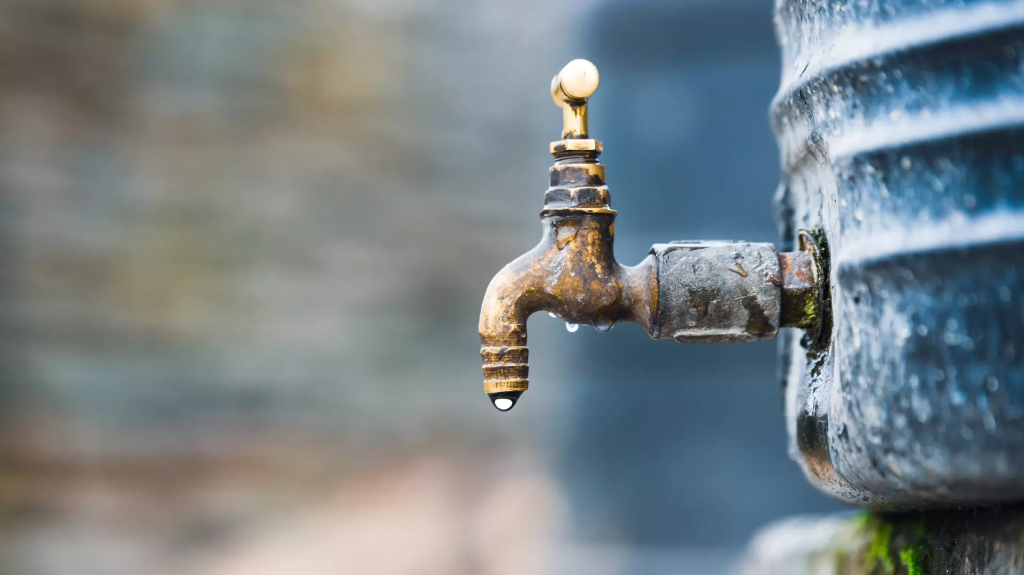
Water Security After a Disaster
DEEP Survival Basics Workshop
February 14, 2026

Slide 2
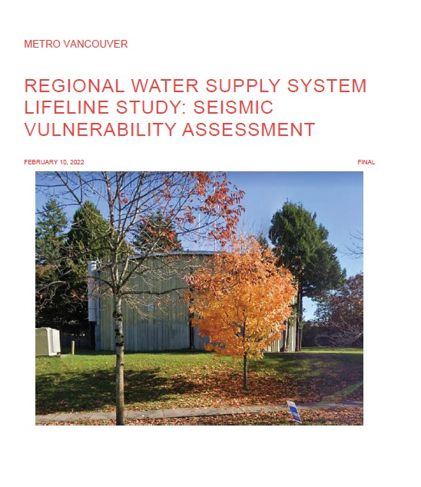
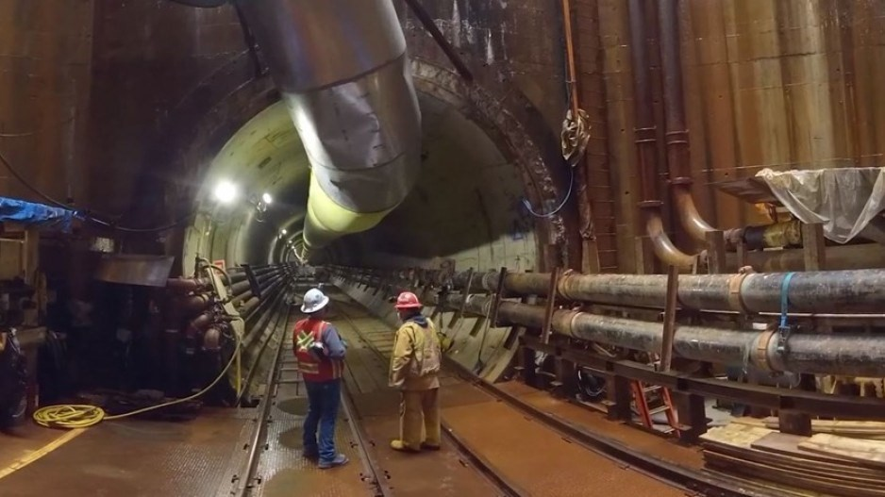
- A February 2022 report, published internally by Metro Vancouver, indicates a 9.0 magnitude earthquake could lead to 267 water main failures across the region.
- The most worrying failures are forecast to occur where all of the region’s main trunk lines pass under bodies of water — from dammed mountain lakes on the North Shore, under the Burrard Inlet, and down the line, below the Fraser River.

Slide 3
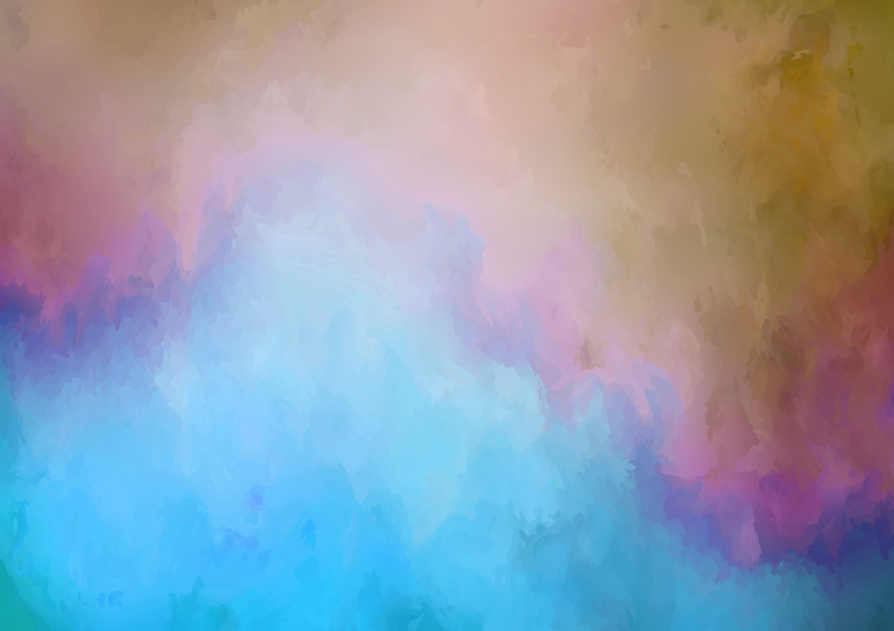
Background
Recent disasters in the United States, Japan and New Zealand have damaged parts of water and wastewater systems, leaving people without access to clean water and flushable toilets for long periods.
Risks to Vancouver and Region
- Megathrust earthquake could shatter Metro Vancouver’s capacity to send water to its 21 municipalities.
- Shallow Crustal Earthquake (Near-surface Fault)
- Secondary Hazards
- Landslides
- Dam Compromise
- Fire Hazards
2022 Metro Vancouver Report Findings
The following damage is expected to
- about 30 per cent of the region’s water mains — or 140 km out of 498 kilometres of pipes — are in areas at severe risk to landslides and liquefying soils.
- Liquefaction also puts at risk Metro’s pump stations — designed to move drinking water throughout the region — and the region’s 26 reservoirs, mostly underground water storage facilities reinforced with concrete and steel.
-In both cases, the most serious damage is expected to occur at inlet and outlet pipes, where rigid connections could lead pipes to snap off.
-If they fail, the reservoir or pump stations will likely be made inoperable-
- The time it would take to fix damage to Metro’s pump stations, reservoirs and water treatment plants ranges from less than a day up to 155 days for heavily damaged reservoirs, estimates the report.
- Metro Vancouver is upgrading key infrastructure, focusing on seismic improvements to reservoirs and using deep, flexible tunnels for pipe crossings to withstand a maximum credible earthquak

Slide 4
Problems with Obtaining Clean Water in Vancouver After a Major Earthquake
Long-Term Outages: Repairs to heavily damaged reservoirs and facilities could take months, potentially leaving residents without running water for up to 155 days.
Broken Transportation Links: Damage to bridges and roads will prevent the delivery of bottled water and rations, making outside aid difficult to distribute.
Limited Emergency Supplies: Current emergency water supplies for the region are estimated to cover only a small fraction (roughly 20% or less) of the actual need.
Firefighting Shortages: Broken water lines will hamper firefighting efforts immediately following the earthquake, necessitating reliance on backup saltwater pumping stations for fire protectio

Slide 5
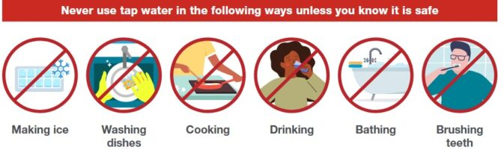

We may need to live without running water for days, weeks, or possibly months.
To stay healthy, we will need water and good sanitation practices. Water is a a bedrock need for survival.
Deadly diseases can spread when water supply is not handled and sequestered safely.
After a Major Earthquake, Assume the Potable Water Supply Is Compromised Until Instructed Otherwise
A strong earthquake can sometimes sever plumbing pipes, and let external materials, microbes and chemicals into your direct water supply. Do not drink tap water in this situation

Slide 6
How Long Without Water?
Research into how long humans can go without water is unethical, but press reports have recorded cases of people lasting 8 to 21 days without food or water. However, scientists believe the number, in most cases, is closer to about 3 days.
You can’t survive without enough water for very long, but the exact amount of time you can live without water varies. That’s because certain factors contribute to your body’s use of water, including your:
- environmental condition
- activity level
- age
- health
- weigh
- sex
- food intake

Slide 7
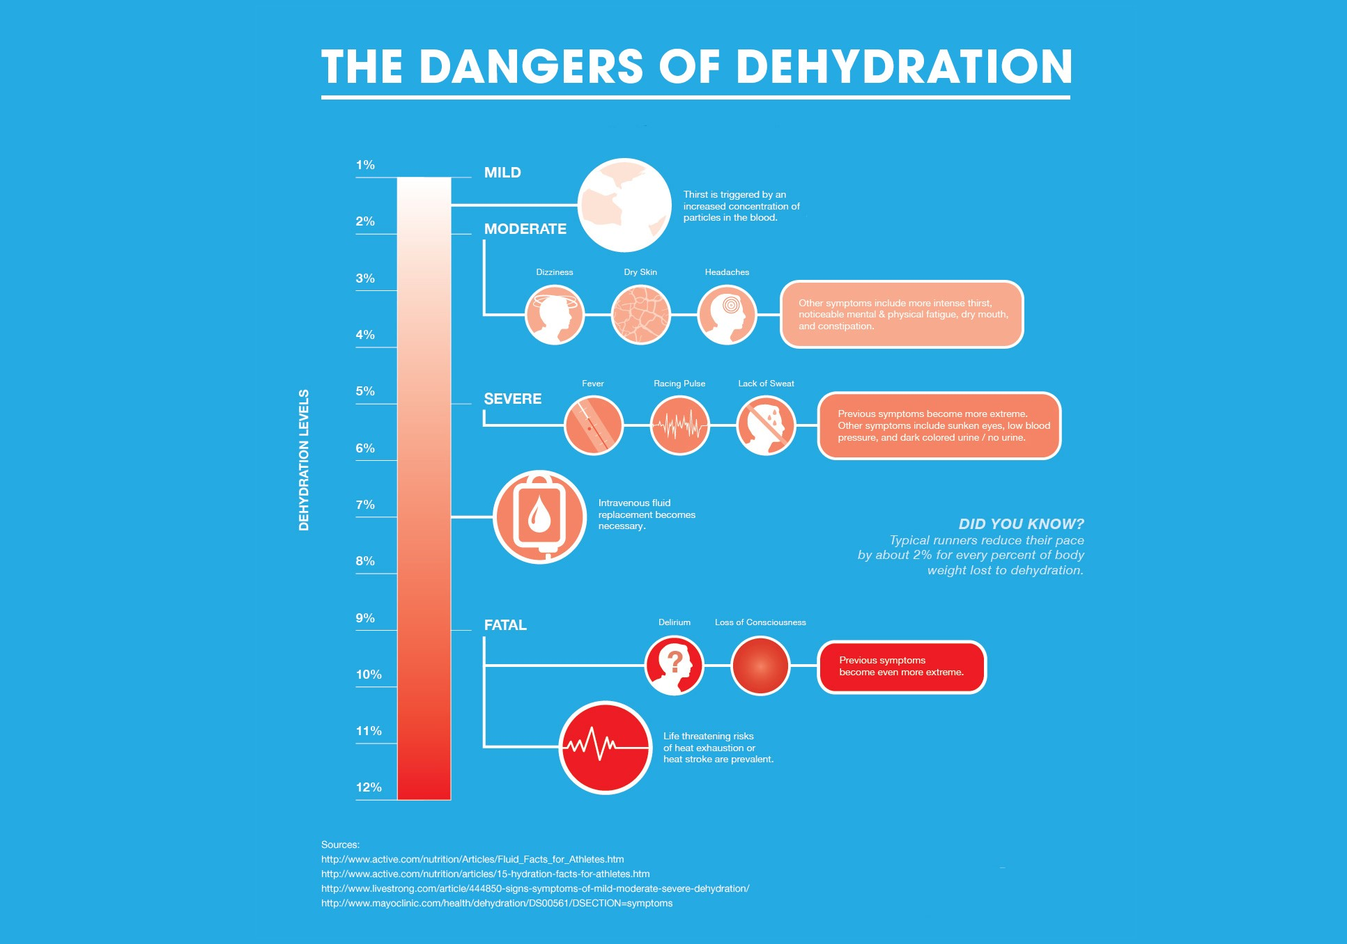
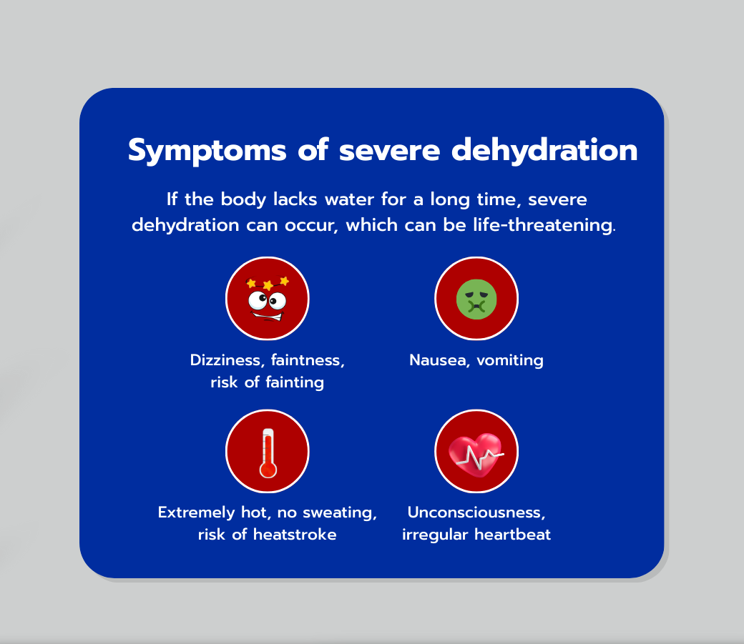
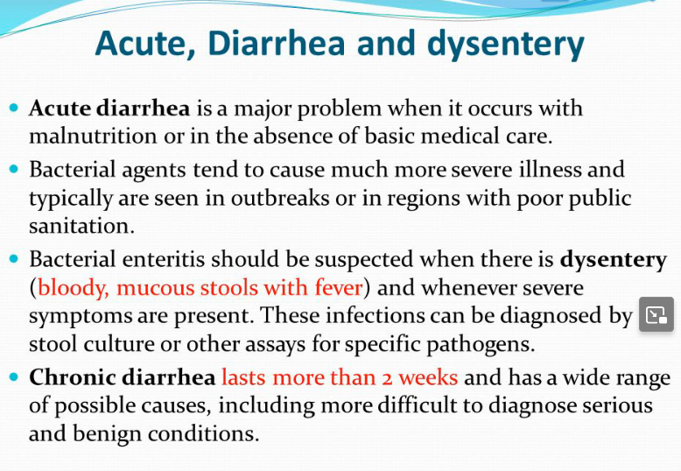
Dehydration

Slide 8
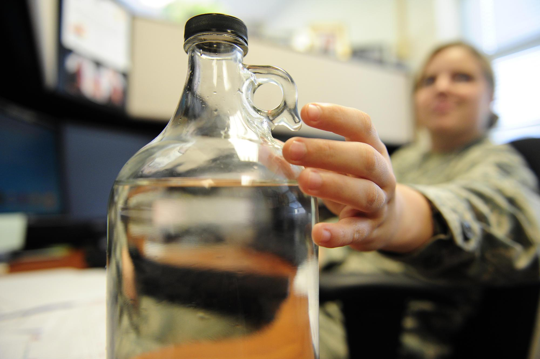
Takeaway:
After the earthquake, many Vancouverites may be without a source of potable water for weeks or months.
If the faucets aren't running, you'll have to rely on your emergency water supply until you can get help.

Slide 9
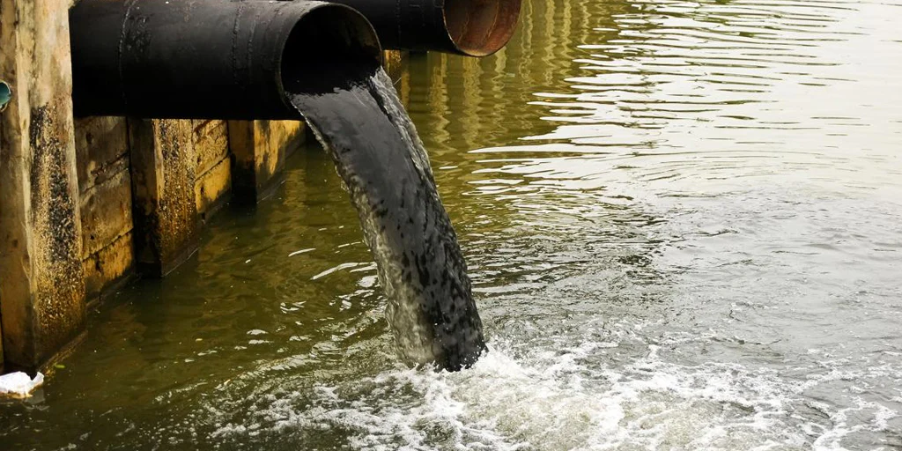
Types of Contamination
Chemical spills: Earthquakes can cause damage to industrial facilities and storage tanks, leading to the release of hazardous chemicals into the environment. These chemicals can seep into water sources, posing a significant risk to human health.
Microbial contamination: Waterborne diseases are a major concern after an earthquake. The disruption of water infrastructure and sanitation systems can spread harmful bacteria, viruses, and parasites in the water supply.

Slide 10
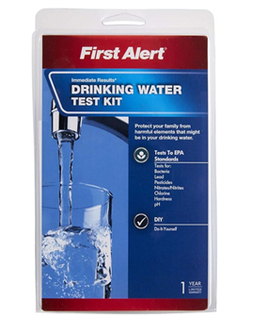
Chemical Contamination
A breach in the water supply chain can introduce mineral impurities. They will probably change the water color, although, because they dissolve slowly, it will take a few days for this to happen.
If the water coming out of the tap is yellow or brown, it almost surely contains iron. A black coloration indicates manganese, and green usually indicates copper.
Although these minerals are toxic in high doses, the human body does not efficiently absorb them from water, so technically, mineral-laden water is safe—if unpleasant—to drink in small quantities.
A test that detects both pesticides and bacteria costs about $25.
The presence of fuel and hydrocarbons is more difficult to detect.

Slide 11
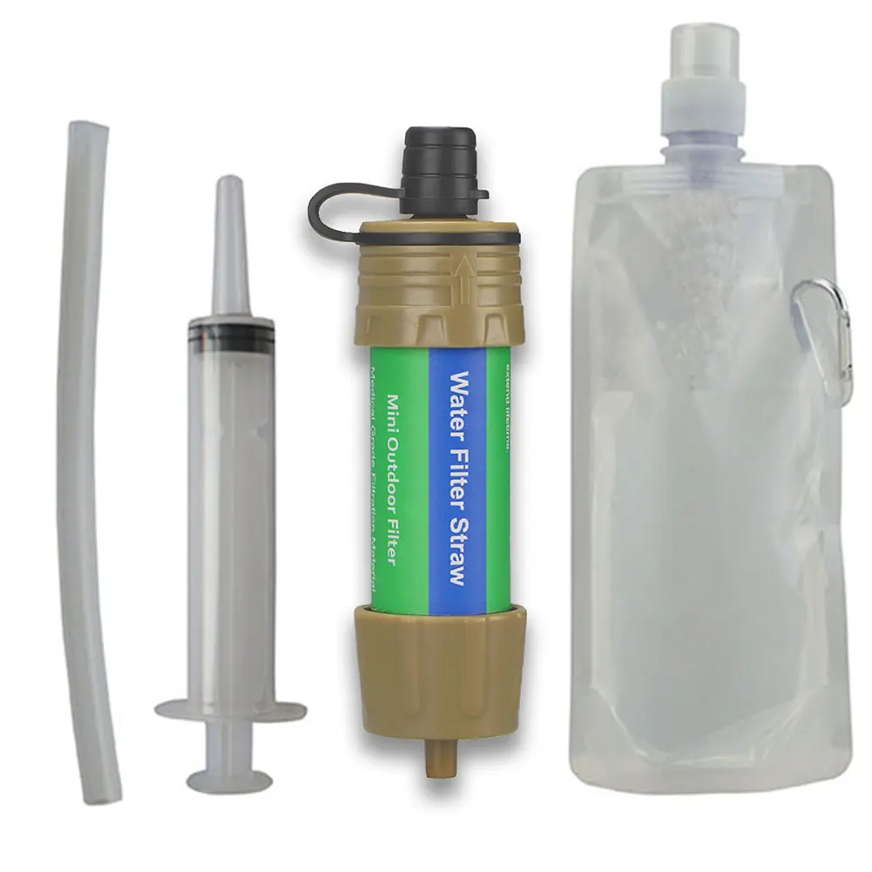
Microbial Contamination
Of more concern are pathogens that may enter the water system through a collapsed water main or a broken pipe, as well as through any body of standing water.
Water that contains amoebae or bacteria is often also discolored, but the discoloration comes from sediment and dirt, not the pathogens. Depending on the degree of contamination, the water coming from the tap may just be cloudy, or it may be brown, and it may have an odor.
It is best just to assume that your tap water has microbe contamination, and treat accordingly.

Slide 12
Potential Water Sources After an Earthquake
Part of earthquake preparedness is to store enough bottled water so that each person has enough to last for 72 hours at the rate of one gallon per person per day. A more realistic estimate is now generally recognized as being two full weeks. In the absence of bottled water, you can get emergency water from other sources, including:
The Water Heater
Screw a garden hose onto the drain plug and empty as much water as you need into a clean bucket. A 40-gallon tank holds an ample 3-day supply for the entire family. Unfortunately, these are now being rapidly replaced with Hot Water on Demand Units
Toilet Tanks
Approximately one and one half gallons. Siphon water out of the tanks using a hose or rubber tube. Do not use water that contains a disinfectant, and do not use water from the bowl.
Ice Cubes
Geeeeze……if it comes to this, you probably are cursing that you’d listed to Chris’ advice on water stocking. Place any ice cubes you have in the freezer in a clean bucket and let them thaw.

Slide 13
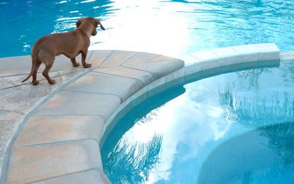
Potential Water Sources After an Earthquake
River, Lake, Creek and Pond Water: If you live near a large body of water, you may have to rely on it for drinking water. Draw water from areas in which it is flowing, not stagnant areas. Do not use discolored water or water on which any debris is floating. Do NOT drink from the Fraser River
Swimming Pools
Swimming pools are maintained and treated and are technically safe to drink. Chlorine content in public pools is slightly more than ~3 ppm, which is the level municipal water supply. pH at 7.4, slightly below they tap water level which of 7.8
A lack of daily circulation will cause fairly rapid degradation without some sort of action on the owner’s part as the chlorine evaporates at a much faster rate than water. This would include continued chlorination as needed, with manual agitation. Also, putting on the cover would be wise.

Slide 14
Pre-Disaster Storage of Water
Store your water in thoroughly washed plastic, glass, fibreglass or enamel-lined metal containers. Never use a container that has held toxic or unidentified substances.
Plastic containers, such as soft drink bottles, are best. You can also purchase food-grade plastic buckets or drums.
A good water container is airtight, breakage resistant, opaque and heavy enough to hold water.
Good choices include 100-200 Litres (25-55 gallon) food grade plastic barrels, 20 Litres (five-gallon) plastic jugs or collapsible water carriers available through camping supply stores, and the two- or four-litre soda pop bottles.
Glass bottles are acceptable, but have a higher chance or breakage during emergency or long-term storage. DON’T USE
Remember that water weighs approximately 1 kg (10 Imperial pounds) per litre. Do not store more than 15 litres (5 gallons) of water (about 15 kg or 50 pounds) in an container that is meant to be portable. Milk containers are not recommended because they do not seal well
Store your water away from gasoline, kerosene, pesticides or similar substances.
Polyethylene plastics can be permeated by hydrocarbon vapours.

Slide 15
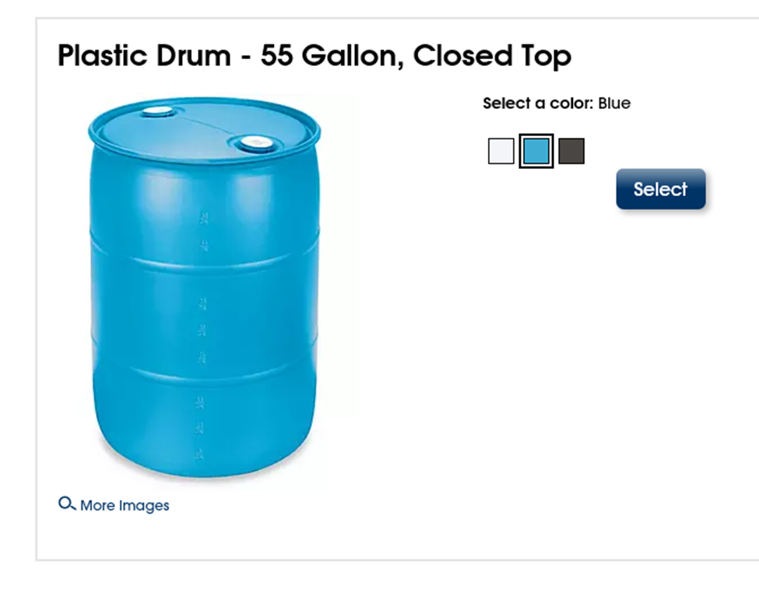
Use a new 55 gal drum if possible, and select a non-white colour, as this will be far more opaque and will prevent much more light from penetrating the side of the container.
Sunlight helps to allow the growth of dangerous microbes.
The barrel must be made out of food-grade plastic. High-density polyethylene (HDPE) is the plastic commonly used to make the popular blue 55 gal drums.
New food-grade water barrels are best but come with a significantly higher price tag. While it is possible to obtain used food-grade water barrels for a fraction of the cost. Never re-purpose a barrel for water storage that has held anything that you would not consume. Clean all barrels well before filling for long-term storage
A standard 55-gallon water barrel measures 36” high x 24” wide. The barrel weighs roughly 22 pounds and 55 gallons of water weighs 460 pounds for a grand total of 482 pounds.

Slide 16
Best Disinfection Techniques
These are the best methods to treat water for long-term storage in a 55-gallon barrel. They will kill any bacteria or viruses that may be in the water.
Add 1/4 teaspoon of calcium hypochlorite to the filled barrel and screw the lid on. Calcium hypochlorite is superior to bleach.
Add 2 Tablespoons of FRESH unscented regular bleach (sodium hypochlorite). Liquid bleach must be fresh to be effective and there are other chemicals in bleach that are needlessly added.
In addition to having one large static storage vessel, keep one or more small (under 10 litre) containers with water in case evacuation is required.

Slide 17
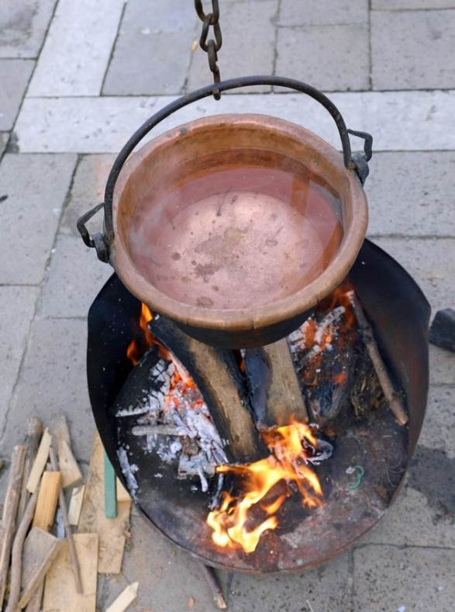
Means of Decontaminating Water
Boiling Water
The most reliable way to purify contaminated water is to boil it, according to several authorities, including the Centers for Disease Control. Bringing the water to a rolling boil for at least a minute kills bacteria, viruses and protozoa. While boiling won't remove mineral discoloration, it will clarify water that has been clouded by organic contamination.
However, it can potentially be unsafe to use fire after an earthquake because gas lines may have ruptured. Boiling water is intensely consumptive of resources such as natural gas and wood. There are several alternatives to boiling for water purification. Here are some common ones that use substances you should be able to find easily:

Slide 18
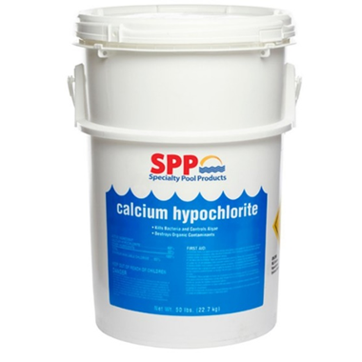
Chemical Treatment of Water
Bleach
Unscented liquid household bleach: Treat each gallon of clear water 16 drops per gallon if the label states the active ingredient contains 2.5% sodium hypochlorite (bleach); 8 drops of 6% bleach, or 6 drops of 8.25% bleach. If the water is cloudy, try to let it settle before adding bleach; if the water does not become clearer, double the suggested amount of drops. Shake or stir the water and let it stand for 30 minutes before using it. DO NOT USE scented bleach, because the chemicals that create scents are harmful.
Granular Calcium Hypochlorite
If you have a swimming pool, you can use the calcium hypochlorite you use to treat the pool water to purify your drinking water. The procedure involves two steps:
Dissolve a heaping teaspoon of calcium hypochlorite granules into 2 gallons of water and stir until the granules have dissolved. It's best to wear eye protection when doing this.
Add the bleach solution to contaminated water in a 1:100 ratio—that is, 1 part bleach for 100 parts water.
This is less toxic for you than is bleach, and is the preferred method of preserving large amounts of water long term

Slide 19
Emergency Water Filters and Purifiers
Filter or purifier?
It is important to know the difference between a water filter and purifier. A filter (more accurately, a microfilter) is designed to physically remove two types of waterborne microorganisms: bacteria and protozoa.
In contrast, a purifier is designed to either kill or physically remove all three waterborne pathogens: bacteria, protozoa and viruses. Thus, to combat viruses, you need a purifier. Or, you can couple a microfilter with a purifying agent.

Slide 20
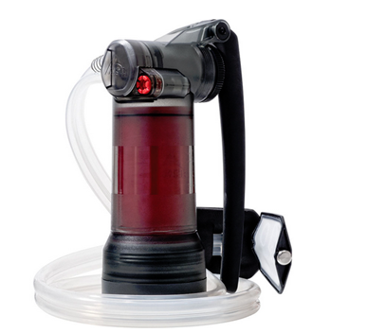
PURIFIERS
Hand Pump Purifier
Effective against: Viruses, bacteria, protozoa, microplastics, dirt
Flow rate: 2.5 L per minute
Style: Hand pump
Best for: 2-4 people; choosing one device that works for backcountry, international travel and emergency use
Originally developed to keep military service members safe in the field. Manually operated. These types of tools use hollow fiber technology, it physically strains out contaminants, including viruses. Flow rate is slow.

Slide 21
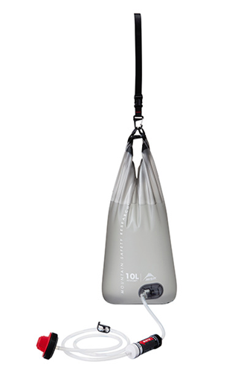
Gravity Purifier
Effective against: Viruses, bacteria, protozoa, microplastics, dirt, tastes, odors and chemicals
Flow rate: Up to 1 L per 2 minutes with optimal system setup
Style: Gravity
Best for: 2-6 people depending on needs; choosing one device that works for backcountry, international travel and emergency use
The gravity purifier uses the same advanced technologies as the original pump purifier in a high-volume, hands-free design to deliver purified water on demand. Some brands use 0.02-micron hollow fiber media to purify but add a carbon component to help pull out chemicals, tastes and odors.

Slide 22
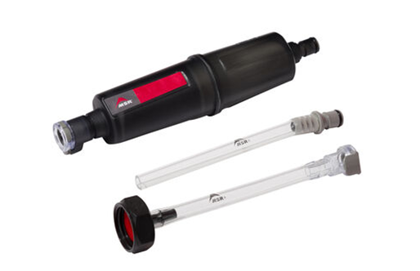
MICROFILTERS
Home Emergency Water Filter Kits
Effective against: Bacteria, protozoa, dirt, microplastics, chemicals, tastes, odors
Flow rate: Depends on your spigot
Style: Attaches to standard-threaded home spigots
Best for: Treating home drinking water if municipal systems are compromised, such as during city boil orders
Home Emergency Water Filter Kits and the like offer a convenient way to treat your home drinking water if it’s ever contaminated, assuming water is still running. This kit allows you to treat the water flowing from your spigot to make it drinkable. The kit’s adapter threads onto standard outdoor spigots, including those often found on backyard cisterns. The microfilter uses hollow fiber technology to remove bacteria, protozoa and particulates, while activated carbon reduces chemicals and tastes. To combat viruses, simply add two drops of bleach to a gallon of treated water and wait 30 minutes. Not effective against chemical contamination.
The MSR kit is protected in hermetically sealed packaging to ensure it’s ready after long-term storage.
.

Slide 23
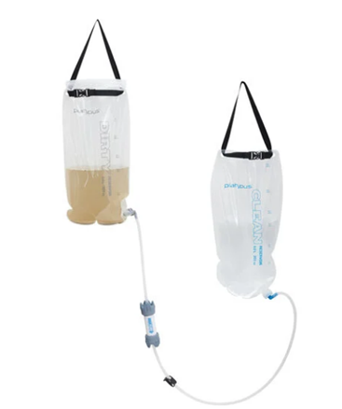
Gravity Purifier
Home Emergency Water Filter Kits
Effective against: Viruses, bacteria, protozoa, microplastics, dirt, tastes, odors and chemicals
Flow rate: Up to 1 L per 2 minutes with optimal system setup
Style: Gravity
Best for: 2-6 people depending on needs; choosing one device that works for backcountry, international travel and emergency use
Platypus brand gravity filtering up to 1.75 liters a minute without any pumping. With two different sizes—6.0L & 4.0L. Offering an 8 or 12 liter total capacity, either model easily supplies filtered water for drinking, washing up, cooking, and cleaning.

Slide 24
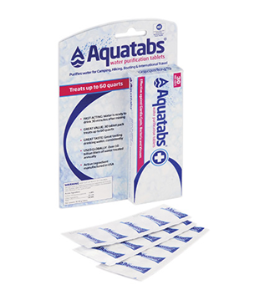
Water Purification Tablets
Effective against: Viruses, bacteria, protozoa
Treatment time: 30-minute wait time while chlorine kills microbes
Style: Chlorine-based tablet
Best for: 1-2 people; adding defense against viruses to any microfilter
Water purification tablets make great emergency backup treatment solutions. Ultralight, inexpensive, compact and protected in individual packaging, they’re easy to toss into an emergency kit (or a backpack). Use them after filtering your water in order to combat viruses.
The problems include once consumed, they’re gone. Also, they don’t work terribly well with turbid or cloudy water.

Slide 25
Plan “B”
When you’ve left it too late….
Start with the cleanest water possible. If your available water is murky or sandy, let the sediment settle, then pour the water into another container to help filter out the sediment.
Boil your water. Be sure to maintain a rolling boil for a full minute. If you live at high altitudes, it’s safer to boil for 3 minutes.
Use regular household bleach. The CDC recommends adding 16 drops (1/8 teaspoon) of unscented, liquid household bleach per gallon of water. Stir and let stand for 30 minutes before drinking.
Distill your water to kill any resistant germs and remove other organics. Distilling requires boiling water and collecting only the condensed vapor.

Slide 26
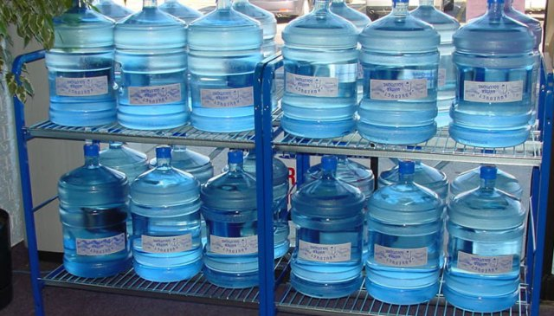
SUMMARY
As you can see, you have several options for disinfecting water in an emergency situation. These are resource and time intensive. It pays to be prepared for the worst, so use these tips if you’re in the process of building your home emergency water supply kit. Or, just couldn’t have been bothered….

